Slide 1
Relationship between Amount of Financial Aid Received and Socioeconomic Background
By Michael Wu, Sara Wu, Angie Mejia, Prenav Bhasin

Slide 2


Motivation
Socioeconomic status encompasses not just income, but also educational attainment, and subjective perceptions of social status and social class by differ in quality of life attributes as well as the opportunities and privileges afforded to people within the society.

Slide 3

Data Sets
FAFSA Dataset
Usage: To find out for a particular location / ethnic group / socio-economic group, how many applied for student loan/grant.
https://studentaid.ed.gov/sa/data-center
United State Department of Agriculture -- Department of Economic Research
Usage: Dataset for Poverty by County
https://data.ers.usda.gov/reports.aspx?ID=17826
United State Department of Agriculture -- Department of Economic Research
Usage: Dataset for Education by County
https://data.ers.usda.gov/reports.aspx?ID=17829
United States Fact Finder
Usage: Downloaded datasets for Population and Unemployment
https://factfinder.census.gov/faces/nav/jsf/pages/community_facts.xhtml
Notes:
The FAFSA dataset can give us insight in how many students are receiving how much grants from State and Federal level. Also, the Education dataset provided by the United State Department of Agriculture -- Department of Economic Research would give us specific knowledge about how many people are attaining which level of education at which county. Combining both the FAFSA and the Education dataset, we can gain insight in whether having financial aid has any correlation with the highest education level attained in a specific location or the highest degree one can get.
On the other hand, we also want to compare the Education dataset with the Poverty Dataset provided by the US Department of Economic Research. We want to see whether financial aid actually help poorer county/state to in the average education level. Since the Poverty dataset is mostly by percent, we believe it might be helpful to also take a look at the Population dataset, which, if combined with the Poverty dataset, can give us the amount of people at each county/state who are in poverty. And using that number, compared with the Education and Financial Aid dataset, we can clearly see whether Financial Aid is actually effective.

Slide 4
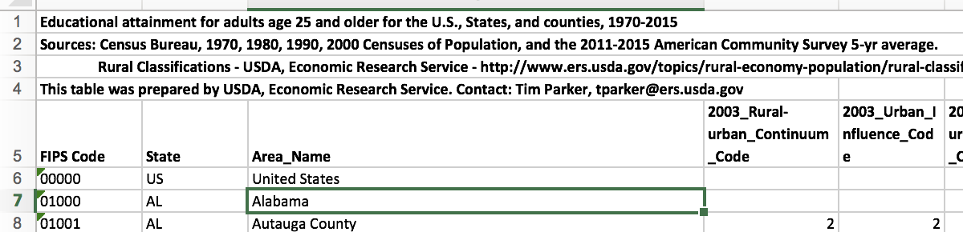

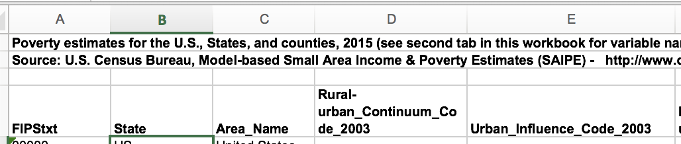
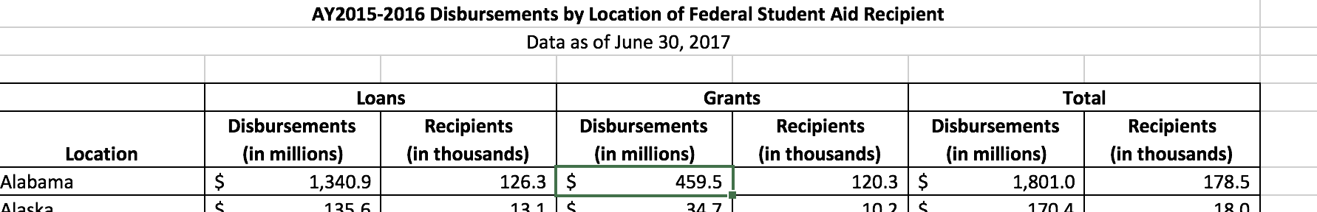
Data Cleaning Process
Read in Data
Panda has a really useful function of panda.read_excel where I can just input the file directory and it will read the corresponding excel for me automatically.
However, as I read it in, I found that each excel has different styles, eg, some has a header that makes that actual data start at row 4 instead of 1. Therefore, I had to manually go into each dataset, find out where does the actual data begin, and pass in an argument called 'header' into panda.read_excel to let panda read from that row and after.

Slide 5
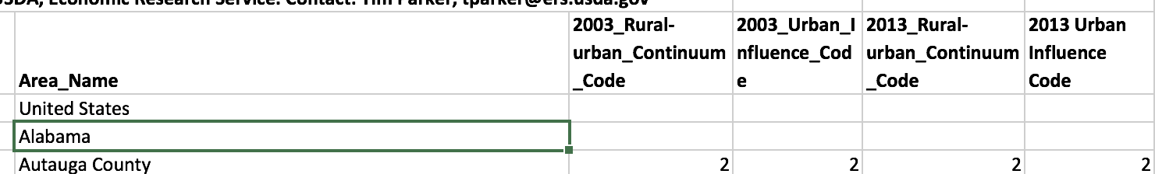
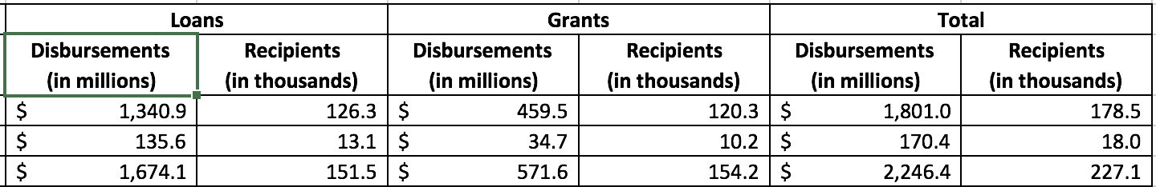
Data Cleaning Process con...
Filtering
The second step would be to filter out datas that we don't want.
The datasets are detailed to a county level. It is too detailed for the purpose of this visualization. And therefore we decided to take only the state stats, which we can do by taking only that values that are in the state dictionary that we created earlier

Slide 6


Data Cleaning Process con...
Organizing
Panda is a relatively new library and therefore, we decided to that datascience library would probably be a better library to use since we all took data 8.
We can do this by calling the Table.from_df method onto any dataframe object.
So we converted all pd dataframe to datascience tables

Slide 7

Description of the system + Demo

Slide 8
Related Work
Educational Testing Service, Poverty and Education:
Minority students disproportionately attend schools that are segregated by race and income. For example, 38 and 43 percent of Black and Hispanic students, respectively, attend schools that have a student body that is composed of 90 to 100 percent minority students.
In states with the highest gaps, household incomes of private school students are about double the household incomes of students in the public schools. In Louisiana, for example, the average household income for public school students is $56,428, compared to $113,773 for private school students.
National College Access Network, An Examination of the Relationship between School District FAFSA Completion Rates and District Poverty Levels:
Focused on FAFSA Completion rates, the poorer the school district the less likely they are to fill it out
Notes:
This report focused on external causes of poverty affecting young children and their schooling. Also, how government solutions could assist with poverty levels and funding public schools. We solely focused on college level students or those graduating from high school and how financial aid is distributed based on the poverty level. This gave us a base to look further into funding for high education.

Slide 9

Problems and Learnings
Inputting Data
Problem:
Every dataset has its own way of enumerating and indentation of title. Processing and cleaning datasets took a lot of debugging effort to read in various dataset effectively.
Learning:
We learnt various techniques of cleaning data and processing, which include removal of irrelevant columns and interconversion between Pandas dataframes in datascience tables.
Notes:
The first is how to read in data correctly. Every dataset has its own way of organizing its values and thus caused problems when reading in. For example, each dataset has its own way of enumerating and indentation of title, and that made us to debug quite a while.

Slide 10
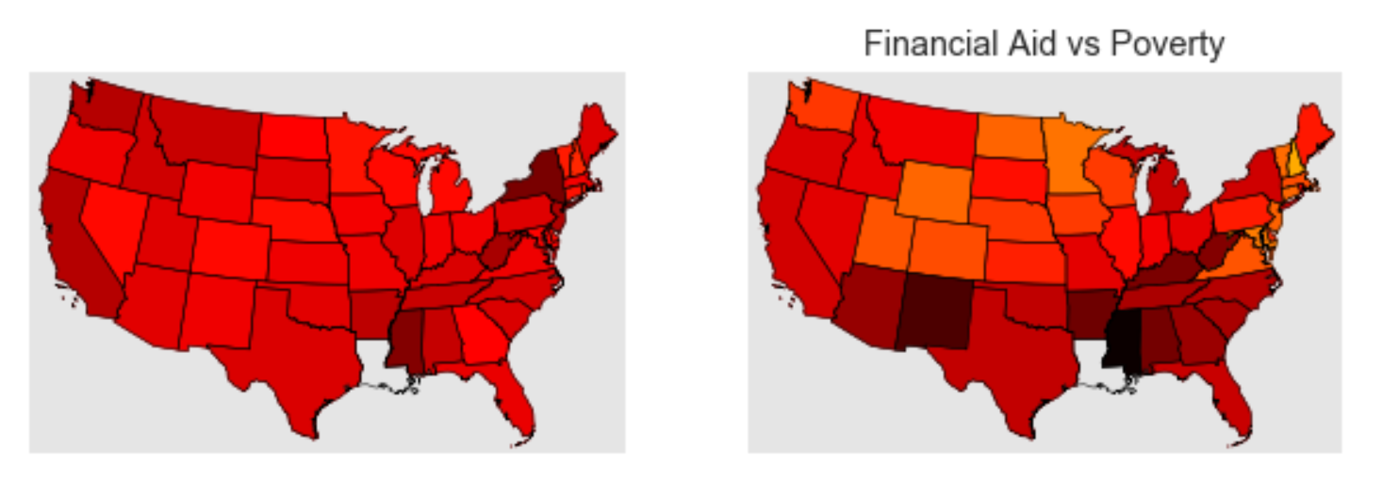
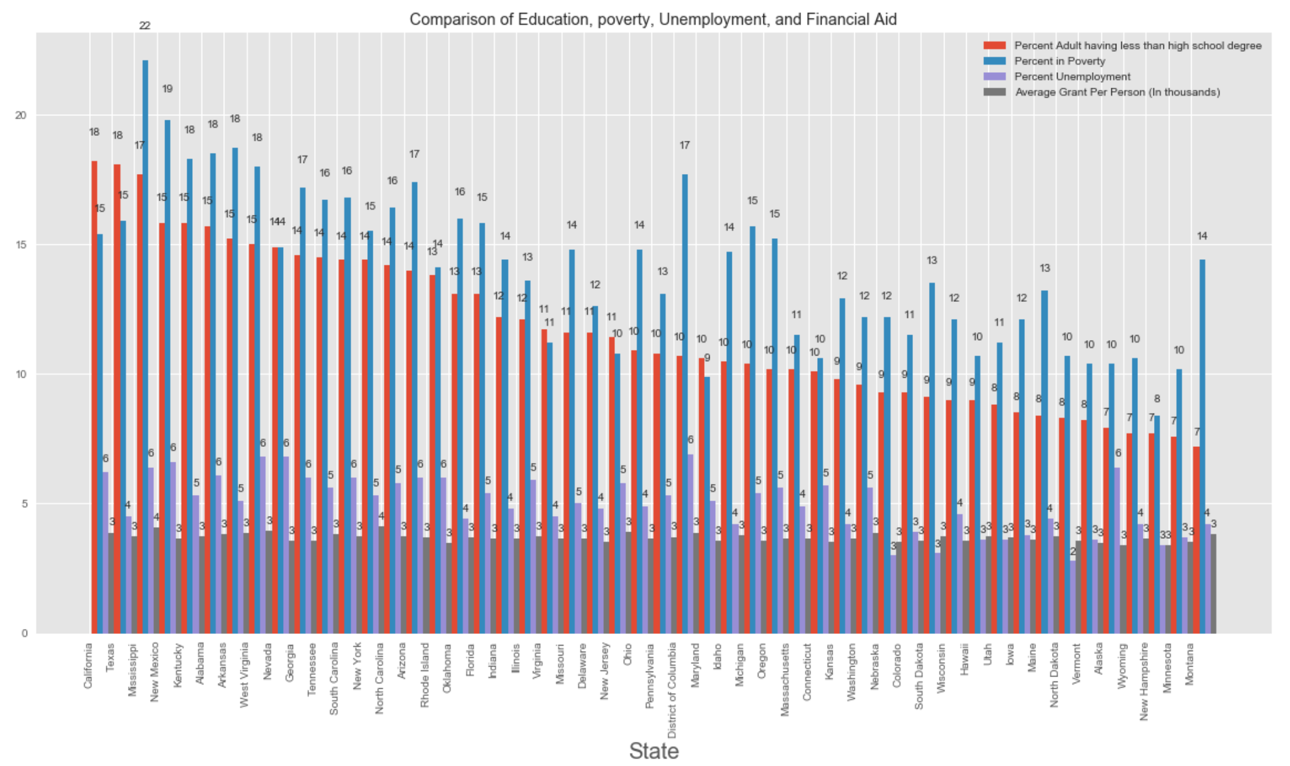
Problems and Learnings
Visualizing Various Kinds of Data
Problem:
Different datasets pose novel and interesting questions. It becomes important to know how to visualize this data effectively.
Learning:
We learnt various techniques of visualizing data with a variety of tools. By using various scatter plots we were able to effectively infer from the data.
Notes:
Another technical difficulty would be that we have too much data and how to effectively visually represent it. We found that making one plot that contain all the information is ineffective because there’s simply too much information and would make it impossible to understand. Therefore, we used multiple scatter plots to plot the relationship between different parameters.

Slide 11
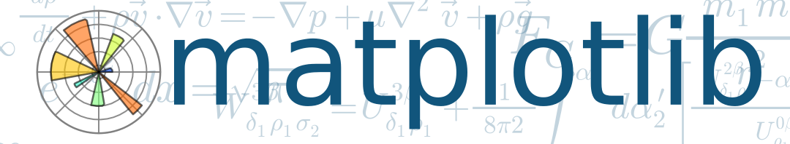
Problems and Learnings
Learning and Using New Libraries
Problem:
The technical difficulty we were faced with was issue of learning new libraries to represent our data better.
Learning:
We learnt new libraries like Pandas and Basemap to carry out more complex data manipulations.
Notes:
And the technical difficulty we spent the most time on was how to use a certain library. For instance, Panda and Basemap is very new to us and it took us quite a while to get the hang of how to use its functions. One way that we overcame this difficulty is to transfer data all into datascience Table since all of us took Data 8 and know how to operate in that environment.

Slide 12
Conclusion

